Slide 1
OPEN EDUCATION RESOURCES
Include Me Innovative Training Course
MODULE 3: Communications and Media Practices
This programme has been funded with support from the European Commission. The author is solely responsible for this publication (communication) and the Commission accepts no responsibility for any use that may be made of the information contained therein 2020-1- FI01-KA203-066490

Slide 2
Welcome to the
Open Education Resources
A unique approach to deliver mediation skills training to adult learners in creative, dynamic ways, allowing them to maximise inclusion through mediation.

Slide 3
1
Communication skills in Mediation
Overview, how you will benefit
2
What is Policy, National Policies, EU policies, how does your message link to them?
In Module 3, you will learn how to become an informed voice to place your messages and ideas in the public space, working towards mediating the status and conditions for peer members of new communities.
You will learn how to craft a powerful and unique message and how to manage practical communication tools.
3
Become an informed voice in media debates and in policy development and resources planning
4
Choose your message as a mediator
5
Tools to inform online and in person
6
Examples of communicating through art and sports

Slide 4
Communication Skills in Mediation
Communication
means imparting or exchanging of information by speaking, writing or using some other medium.

Slide 5
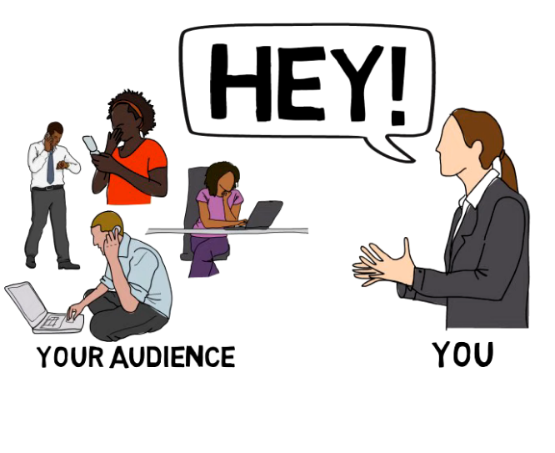
Communication skills
Communicating “correctly” is not always easy in practice. Communication skills aid us in cooperating constructively with each other and in avoiding misunderstandings.
How do we communicate well in a challenging environment?
CTR + Click ON THE image to watch the video

Slide 6
Two types of communication
Verbal communication is transmission of information or message through spoken words.
Non verbal communication is transmission of message through gestures, written words or attitude.
VERBAL
NON
VERBAL
Non Verbal communication is often more spontaneous than verbal communication. It can provide more accurate information as it takes place under less conscious control.

Slide 7
LET’S SUMMARISE!
The 4 Skills of a Great Communicator are:
Assess
A skill to assess the audience and own style
Message
A skill to craft an effective message
Document
A skill to change formats of the message delivery
Deliver
A skill to deliver effectively

Slide 8
Communication skills in mediation
The most important communication skills in mediation are:
3
Body
Language
4
Active
Listening
Asking the
Right
Questions
Listening
With
Empathy
1
2

Slide 9
1. Active listening
A mediator is required to be a good listener as parties participate in mediation with various emotions.
An active listener listens for both what is said and what is not said.

Slide 10
The commonly used techniques of active listening by mediator:
Summarising: The mediator outlines the main points made by the speaker.
Reflecting: The mediator confirms they have heard and understood the feelings expressed by the speaker.
Re-framing: The mediator helps the parties to move from position to interests.
Acknowledging: The mediator verbally recognises what the speaker has said without agreeing or disagreeing.
Deferring: The mediator postpones the discussion until later.
Encouraging: The mediator encourages the parties if they feel upset.
Restating: Mediator reassures the statements they have heard from the speaker.
Silence: The mediator needs to understand the silence of the parties.
Order: Mediator sets the sequence of topics, claims-
SOURCE: https://viamediationcentre.org/readnews/MzY5/Significance-of-communication-in-mediation

Slide 11
2. Listening with Empathy
Listening with empathy represents the ability of the mediator to understand and appreciate the feelings and needs of parties, and then convey to them.

Slide 12
3. Body Language
The appropriate body language of the listener indicates to the speaker that they are attentive.
Example: symmetry of posture, a smiling face, leaning gently towards the parties for listening

Slide 13
4. Asking the Right Questions
The right questions help both parties and mediators to understand what the issues are.
Mediator must gather information of high quality by asking relevant questions.

Slide 14
Mediation Skills:
Communication in Mediation,
Prof. Greenberg
Click to watch the video
Prof. Elayne Greenberg explains communication skills that a mediator needs to have.

Slide 15
2.
What is Policy, National Policies, EU policies, how does your message link to them?

Slide 16
What is Policy?
Policy is a set of values and objectives that guide the work of organisations and bodies.
This includes, for example:
- National Government policies
- European Union policies.
Policy is important because it tells us what organisations and bodies plan to achieve and how they will be guided in their work.

Slide 17
To communicate with authority, we need to understand the policy context/the big picture. The power of being 'on message' with policy gives credibility to your message.

Slide 18
EXAMPLE
Top tip!
Government policy
Government policy tells us what the Government’s priorities are and what it plans to accomplish.
It sets out the commitments it is making on a range of different issues. For example: education and training, employment, mental health, the rights of people with disabilities, migration and so forth.

Slide 19
How does your message link to policies?
For example:
The messages and activities that take place as part of migrants’ mediation ad advocacy can help to achieve national inclusion and integration policy objectives.
Policies should support initiatives that promote active citizenship of migrants
Your message can connect migrants and decision makers to ensure that migrants have a voice in decision-making that affects their lives
Your messages could feed into the needs analysis for any migrant inclusion and integration strategies as well as general development strategies at local, national and international levels

Slide 20
Example of Policies
The Migrant Integration Strategy
(Ireland, national level + local levels – each county benefits from having one)
Read the full article here-Click the image!

Slide 21
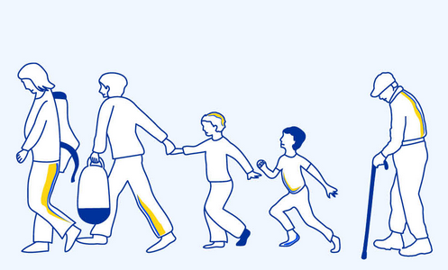
EU temporary protection for displaced persons
This infographic collates questions and answers on temporary protection, including who can benefit from it, their rights and the duration of the mechanism:
https://www.consilium.europa.eu/en/infographics/temporary-protection-displaced-persons/

Slide 22
2
Become an informed voice in media debates and in policy development and resources planning

Slide 23
How to become more informed?
Local authorities
play a crucial role in informing citizens about integration and inclusion trends. Faster integration can lead to increased support for migrants and easier convergence between native-born and immigrants.
Source: https://www.oecd.org/migration/mig/migration-strategic-foresight.pdf

Slide 24
GET MORE INFORMED and CONNECTED
Follow and engage in a positive way with relevant accounts of policy makers, local authorities etc on social media
Listen to and amplify new migrant perspectives
Engage with actors or media who are driving the agenda on international migration
Keep a close eye on international organisations which share data, best practices, and information

Slide 25
Examples of information sources:
International Organization for Migration
Absolutely intercultural! podcast
Engage with the Outside Multicultural Magazine:
Facebook: https://www.facebook.com/OutsideMulticulturalMagazine
Keep a close eye on
The Eu Migration Policy https://www.consilium.europa.eu/en/policies/eu-migration-policy/
Website: https://www.iom.int/
Facebook: https://www.facebook.com/IOM
Instagram: https://www.instagram.com/unmigration/
Listen to the podcast:
https://www.absolutely-intercultural.com/

Slide 26
Top tip!
Top tip!
Try not to be intimidated by authority. Build relationships.
Learn to question responses with which you do not agree. Do this in a very positive way.
This will have an effect on the way you form your message
which will become more authentic and hold more value!

Slide 27
Becoming informed about the community’s needs
Effective Migrant Community Mediators represent the rights and interest of people within migrant communities
Effective mediation, of any kind, requires building a solid strategy or plan and practicing skills to help you feel comfortable and confident in reaching your mediation goals

Slide 28
In order to make your mediation efforts effective you should:
1
2
3
4
Develop a solution (goal) and strategy to address the problem
Break down
the problem
Educate
yourself
Identify the
rights involved

Slide 29
But before you start...
Overcome and BECOME!
Remember the people you are trying to help and don’t just focus on the process
Who are the people you are reaching?
How will your intervention affect them?
What are their stories?
Is there something in their circumstances that confuses you, that you do not understand?
Do you think you would have different needs, reactions, feelings if you were them?
Can you accept what they are expressing, feeling? Do you accept the differences?
Once this reflection is done, you are ready for the next steps.

Slide 30
3
Choose your message as a mediator

Slide 31
CRAFTING AN EFFECTIVE MEDIATOR’S MESSAGE
In the next 6 steps,
we will show you
how to craft an
EFFECTIVE MESSAGE

Slide 32
Required skills for peer mediation
Describe the problem, who does it affect and impact
1. Engage your audience
Be friendly
2. Present the problem
Make a statement that gets your audience’s attention right away. Keep it short, use only a sentence or two!

Slide 33
An example or story puts a human face on the issue and makes it real and more compelling. Again, make sure the example is relevant to your audience
5. Connect the issue to the audience
3. Provide facts
4. Tell a story
Data is important to demonstrate that a problem exists and to support your position. Look for facts that are relevant to your audience
Show your audience how this interest fits with what they care about, want or need

Slide 34
Clearly state what you want the person to do.
Understand the parties
Form a message
6. Make your request
(the “ask”).

Slide 35
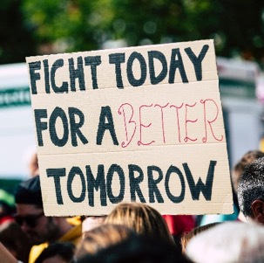
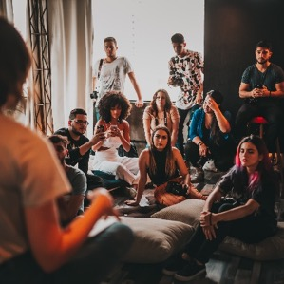
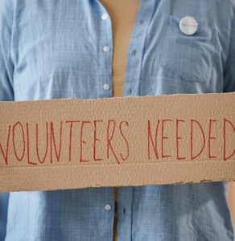
LET‘S VISUALISE – 6 great examples of messaging!
ENGAGE
PRESENT THE
PROBLEM
FACTS
TELL A
STORY
CONNECT WITH AUDIENCE
ASK
CLICK on each image to follow the MESSAGE*

Slide 36
Importance of voice and tone of voice
≠
VOICE
TONE
What’s the difference between voice and tone?
Think of it this way:
You have the same voice all the time, but your tone changes.
You might use one tone when you're out for a dinner with your closest friends, and a different tone when you're in a meeting with your boss.
Your tone also changes depending on the emotional state of the person you’re addressing. You wouldn’t want to use the same tone of voice with someone who’s scared or upset as you would with someone who’s laughing.

Slide 37
VOICE
Try to be:
PLAINSPOKEN
GENUINE
HOPEFUL
BALANCED
Walk in your audiences' shoes, what do you want them to hear?
Passionate, real, accesible, human, not perfect
Show that you expect everything to turn out positively
Seriousness with engaging content

Slide 38
TONE
Try these:
Voice stays the same, tone changes depending on the listener
FORMAL
SERIOUS
RESPECTFUL
ENTHUSIASTIC
VS
VS
VS
VS
CASUAL
FUNNY
IRREVERENT
MATTER OF FACT

Slide 39
EXERCISE
Write down all the characteristics of your voice and the tone of voice you would use to communicate your Community Mediator inclusion messages to the public!
________________________________________________________________________________________________________________________________________________________________________________

Slide 40
TASK: Communicating social actions!
SCENARIO NO. 1
SCENARIO NO. 2
Imagine being in an elevator/lift with an influential decision-maker for one minute and sharing information about your mediation action.
Now, imagine that you are in your community, and you have just entered the lift wearing a T-shirt that says, ‘Active Citizens’. An influential decision-maker steps into the lift and asks you ‘What is Active Citizens?’
You have 2 minutes to answer. What do you say?
Source: Active Citizens facilitator’s toolkit, BRITISH COUNCIL

Slide 41
EXAMPLE OF POWERFUL TONE OF VOICE
Kries – „Ivo se šeće“
The Good Hosts campaign
Click to watch the video
The „Dobri domaćini“ campaign aims to support young homeless creatives, raise funds for the protégés of the SOS Children's Village Croatia and refugees who want to pursue art, but are unable to obtain the necessary equipment and training due to their life situation.

Slide 42
Let‘s reflect!
What was the message of the song
„Ivo se šeće”?
What media was used to talk about the message?
Would the message have the same strength if it was delivered in a different way?
Write down 5 things you have now learned from this example, about forming your own message!

Slide 43
4
Communication Tools to inform - in person and online

Slide 44
„
The most important thing in communication is to hear what isn't being said
„
Peter Drucker

Slide 45
IN-PERSON COMMUNICATION CAN HAVE IT’S BENEFITS
The bonds are stronger,
Participation is boosted,
Misunderstandings reduced

Slide 46
How to improve in-person communication
Want to develop communication skills? Start with respect!
1. Think it through. There are many communications frameworks, but if you want to improve your communication skills, start by getting in the habit of thinking through these 5 questions for any communication you create:
Why are you communicating?
Who is the receiver, audience, or participant?
What is your goal or objective? Common objectives of work communications include: to request (resources, participation, permission), to inform, to persuade, to connect. At what stage of your mediation path are you?
SOURCE: https://www.betterup.com/blog/why-communication-is-key-to-workplace-and-how-to-improve-skills?hsLang=en

Slide 47
How to improve in-person communication
2. Give it time. Great communication benefits from having enough time to think it through. Plan what you want to say and review your communication to make sure it is actually doing the job you need it to. For written communications, especially, this means: revise, revise, revise. Remember, great communication might seem effortless, but it rarely is.
3. Make it easy. For a mediator, communication almost always has a larger goal. People are busy. Don’t make them work too hard to understand what you are saying and what you need them to do. In both written and spoken communications, this often means leading with your main point or objective. State your objective and main point in the beginning so your audience knows where you’re going. Then fill in the details and complications.
SOURCE: https://www.betterup.com/blog/why-communication-is-key-to-workplace-and-how-to-improve-skills?hsLang=en

Slide 48
How to improve in-person communication
4. Experiment and diversify. Work on developing different tactics for different communication needs. Focus on experimenting with one aspect of your communication at a time. For example, spend a week paying extra attention to how you structure informal communications. Then spend a week trying different structures for formal meetings or updates.
5. Practice and reflect. Be deliberate about reflecting on what goes well and what doesn’t in your day-to-day communications. Maybe an email to a policy maker that didn’t go well: read it again. Can you see how it might have been misinterpreted? What would you do differently next time? Similarly, if a conversation with a peer didn’t yield the expected results, try to identify whether you clearly communicated what you needed.
SOURCE: https://www.betterup.com/blog/why-communication-is-key-to-workplace-and-how-to-improve-skills?hsLang=en

Slide 49
How to improve in-person communication
6. Consider the full package. Consider recording yourself through a few interactions to gain insight into what your full package is communicating in your daily interactions with your team. Do you make eye contact? Is your facial expression relaxed and confident, or tense? As a leader, do you invite participation from others? Do you leave space for questions and clarification?
7. Seek feedback. Ask a few trusted peers and your mentor/educator to rate your communication skills. Start by asking them to rate (i.e., on a scale of 1-10) your written and spoken communication separately. Then ask these 3 questions:
What one thing should I start doing to communicate better with you?
What one thing should I stop doing in my communications with you?
What one area or skill should I work on to improve how I communicate in this organization?
SOURCE: https://www.betterup.com/blog/why-communication-is-key-to-workplace-and-how-to-improve-skills?hsLang=en

Slide 50
In-person Events, a powerful engagement tool
If you need to share information with the public, an event is a powerful method. Be clear on:
What is the purpose or goal of the event? Purpose or goal should always drive your choice of tool.
How many attendees are you expecting?
Do you want audience to interact with one another to share information and ideas, or just to recieve the messages
How much time and/or other resources do you have to prepare for the event? All in-person events require time and planning. Typically, more time and resources are required to plan and implement tools that involve more intensive interaction among stakeholders.
SOURCE: https://www.epa.gov/international-cooperation/public-participation-guide-tools-inform-public

Slide 51
Types of events
Tool | # of Participants | Best Suited for
Public Meetings | Limited by room size. | Smaller communities and communitise where stakeholders are willing to attend meetings.
Briefings | Generally designed for smaller groups. | Reaching out to established groups.

Slide 52
Public meetings bring diverse groups of stakeholders together for a specific purpose. Public meetings are held to engage a wide audience in information sharing and discussion. They can be used to increase awareness of an issue or proposal, and can be a starting point for, or an ongoing means of engaging, further public involvement. When done well, they help build a feeling of community.
Public Meeting
Advantages
Introduces a project or issue to a community
Provides all participants a chance to voice their concerns, issues, and ideas
Disseminates detailed information and decisions throughout the community
Provides opportunities for exploring alternative strategies and building consensus
Can create consensus for action on complex issues that require broad-based community input

Slide 53
Briefings
Briefings are generally short presentations provided directly to community groups at their existing meetings or locations – such as social and civic clubs – to provide an overview or update on a project.
Advantages
Informs stakeholders of an initiative and provides them with a chance to ask questions
Keeps key stakeholder groups informed and involved in a less formal and expensive process than large public meetings
Can be held more frequently than larger public meetings
Generally used with existing groups who hold meetings
Are informal and help to build community good will and create a more effective atmosphere for dialogue and responding to specific questions

Slide 54
Online communication
Recent studies have identified various ways in which online communication is different than communication in person in terms of:
Body language
Voice
Eye contact
Perception about silence
Source: http://mediationblog.kluwerarbitration.com/2021/05/17/mediators-like-online-mediation-and-other-verifiable-facts/

Slide 55
How to improve online communication
Use the communication tools: Zoom, Skype, Microsoft Teams, or another provider.
Use the advocacy tools: Social media relevant to your community, websites and blogging (check out WORDPRESS, WIX, or SQUARESPACE as your free options.
Schedule regular video calls to your peers and community members
Work on providing more participation:
Involve everyone
Listen
Use whiteboards for participation: check out Jamboard

Slide 56
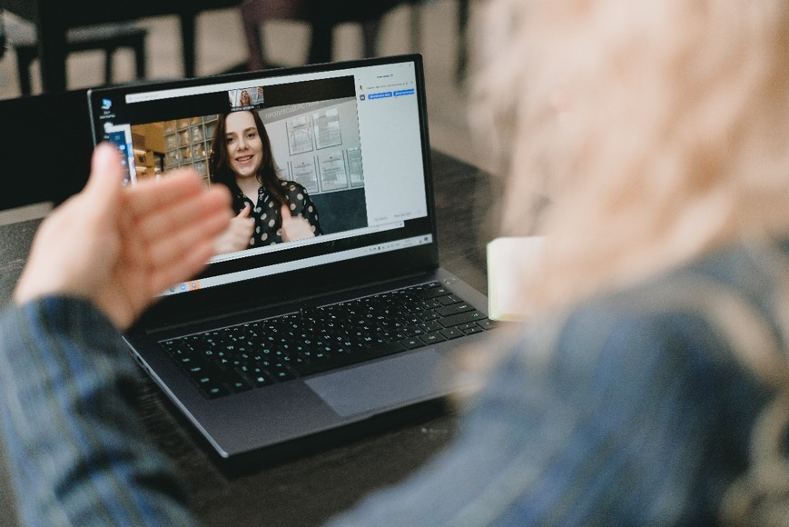
Positive and negative trends for online mediation
Strategies are being developed with a goal to improve online communications. Mediators may be able to improve their bond with participants by adapting their communication styles.
Online communicators attempt to compensate for the absence of physical presence and the technical constraints by smiling more and speaking louder.
CTR + Click on the IMAGE to read the article ABOUT four causes for ‘Zoom fatigue’ and their simple fixes

Slide 57
6
Examples of communicating through art, sports, and other means

Slide 58
Eurovision winners 2022 as mediators of peace
READ THE ARTICLE
Eurovision winners sing at Polish border on way back to Ukraine: https://www.theguardian.com/tv-and-radio/2022/may/16/eurovision-winners-sing-at-polish-border-on-way-back-to-ukraine

Slide 59
Double click and read
„Mediation is another word for FRIENDSHIP.
Migrant Community Mediators provide friendship though many different forms.”
- Migrant Community Mediators project team

Slide 60
Mediation through poetry!
The Migrant's Reply
By Indran Amirthanayagam
We have been running for so long. We are tired. We want to rest.
We don't want
to wake up tomorrow and pack our bags. We have gone 10,000 miles.
We have
boarded a row boat, tug boat, bus, freight train. We have a cell phone
and some bread.
Our eyes are dry. Our breath needs washing. What next? You are
putting up
a wall on your Southern flank? What an irony. The country that
accepts refugees
does not want us. We qualify. We have scars and our host
governments hunted
Read the full poem here: https://www.poetryfoundation.org/poems/154739/the-migrant39s-reply
Indran Amirthanayagam, "The Migrant’s Reply" from The Migrant States. Copyright © 2020 by Indran Amirthanayagam. Reprinted by permission of Hanging Loose Press.
Source: The Migrant States (Hanging Loose Press, 2020)

Slide 61
Example of Mediation through Creating a Movement
New Women Connectors is an initiative led by migrant and refugee women who have mobilised themselves in becoming a collective movement, demonstrating what the strength of unity and the power of raising one’s voice can do. Their aim is to raise awareness about the challenges and opportunities refugee and migrant women face in Europe, through facilitated platforms of discussion, thus creating a shift in communities and policy at large. https://www.newwomenconnectors.com

Slide 62
Migrant Community Mediation through SPORTS
Get Inspired resources:
How Senior World Medalist Nzingha Prescod Advocates For Diversity and Inclusion In Fencing: https://baucemag.com/nzingha-prescod-advocates-for-diversity-and-inclusion-in-usa-fencing/
The British Asian Rugby Association (BARA) is a dual code, inclusive, UK not-for-proﬁt NGO of ten years standing. It has a history of campaigning for equality and inclusion for Asian communities (not exclusively) in rugby, and has delivered tangible projects which break down cultural and religious barriers and provide sporting beneﬁts to a much under- represented minority ethnic community: https://sportsbanter.com.au/british-asian-rugby-association-bara/

Slide 63
Get inspired
Official statics say that “at least” 86% of Rosengärd (a city district in the center of Malmö Municipality, Sweden) residents were of foreign origin, the unemployment rate up to 60% and that 71% of the children were living in relative poverty. School results were among the worst in the country and the crime rate, one of the highest.
This is where, to migrant parents from Bosnia, a boy was born in 1981. His name is Zlatan Ibrahimovic. Facing dificult circumstances in his childhood, the boy grew up to become one of the biggest foodbal players of all time, overcoming many obstacles and becoming a role model, especially for many young people with a migrant background.
Link to his book I Am Zlatan Ibrahimovic : Zlatan Ibrahimovic : 9780241966839 (bookdepository.com)

Slide 64
Watch the video:
The trailer for the the documentary "Ibrahimovic - from Rosengård more than one goal”
“Nobody believed I could do it. Everybody was trash‑talking. They thought I will go away because I have a big mouth. They thought this guy’s vision is crazy. It will not happen. But I had these dreams of where I would end up. And now here I am.”, Zlatan Ibrahimovic, for the Guardian

Slide 65
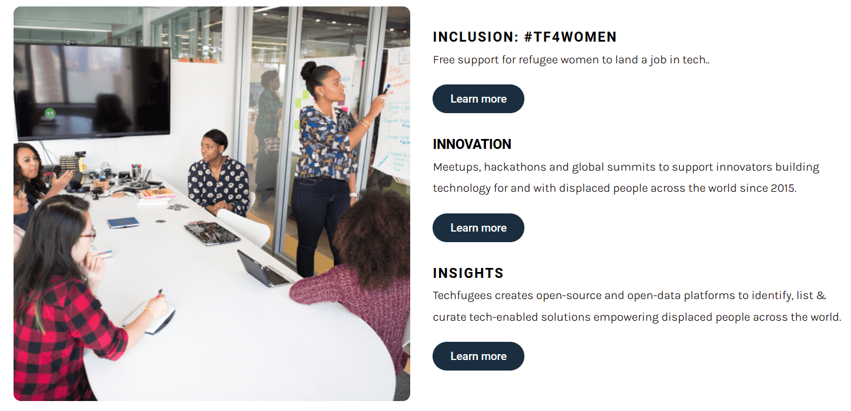
Example - Techfugees:
Empowering displaced people with technology
Techfugees is an impact driven global organisation nurturing a sustainable ecosystem of tech solutions supporting the inclusion of displaced people.
https://techfugees.com/

Slide 66
Watch this video to learn about:
mediation through food and volunteering
Find out more about Ellie Kisyombe – from volunteer community lead projects, to elections, click HERE

Slide 67
Main conclusions to this module
POLICY
MESSAGE
COMMUNICATE
ARTS & SPORTS
- is your friend
Create your vision and give yourself time to craft your message
There are many ways and formats
No better way to speak up than through arts and sports
Get to know relevant policies
Use the tools created to support you

Slide 68
Thank you and congratulations on finishing Module 3!
Next up:
Module 4 - Effecting change – strategies and new approaches
www.includemeproject.eu

